Slide 1
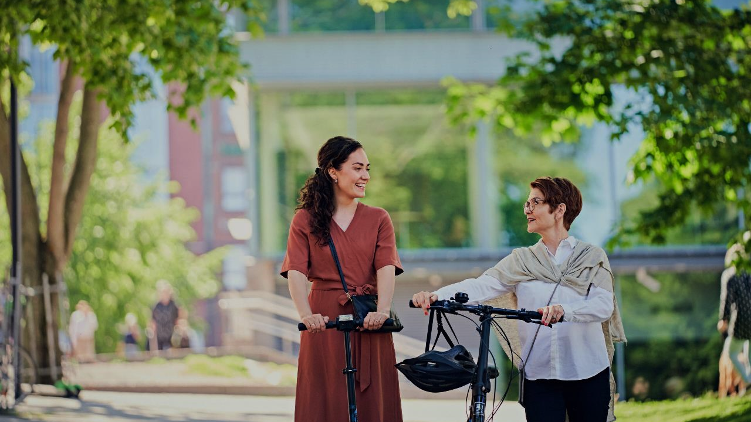


RRF – Recovery and Resilience Facility in Business Finland
Teija Lahti-Nuuttila
Executive Director

Slide 2
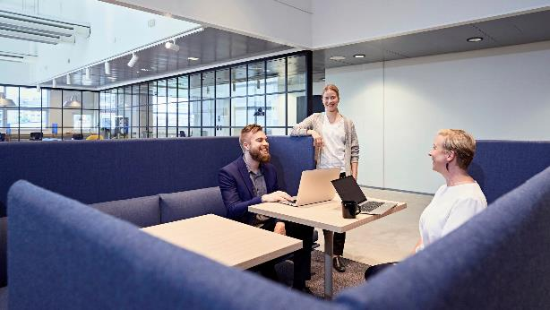
Business Finland
A Finnish public organization that provides innovation funding and internationalization services.
Promotes Finland as a travel and investment destination.
The organization employs 760 advisers at approximately 40 locations world-wide and 16 locations in Finland.
Business Finland is part of the Team Finland network.

Slide 3
EUR 400 million funding for innovation and investments
PILLAR 3
R&D&I
Leading company (Veturi) funding
Key enabling technologies
Innovation infrastructure/ Living labs
Growth companies funding
Businesses impacted by the pandemia and growth businesses
Sustainable and intelligent travel
Travel RDI
Creative industry pilots
Low-carbon exports
Health and wellbeing exports
PILLAR 1
Green transition
Hydrogen economy
Circular economy investment grant
Battery technology investments
Low carbon built environment
PILLAR 2
Spearhead technologies
6G test beds
Microelectronics (IPCEI)
Notes:
Aputekstiä Teijalle:
- Business Finland has helped 344 Finnish companies to utilize the EU's recovery funding.
- Companies have received EUR 392 million through Business Finland.
- 28 RRF funding calls in 2021–2023, 844 applications, around 40% of the applicants received funding.

Slide 4



Preliminary results
Turnover
in target year
11,5 B€
Exports
in target year
9,8 B€
Jobs
in target year
13 642

Slide 5



Examples of RRF-funded projects
A Finnish family-owned company Kuljetusrinki invests in
an ultra-modern robot sorting line
61.3 million euros for the development of Green Hydrogen
Near Real’s AI-assisted remote appointments save time and money
Notes:
Aputeksitä Teijalle:
1. Investointi: Kuljetusrinki The company has invested in a robot sorting line utilized in waste treatment and has received EUR 1,420,900 of Business Finland’s RRF funding for this purpose. The technology, which will be introduced in 2023, will increase the efficiency and growth of Kuljetusrinki Oy’s business while reducing the environmental burden.
https://www.businessfinland.fi/en/whats-new/cases/2023/a-finnish-family-owned-company-invests-in-an-ultra-modern-robot-sorting-line
(Pitsausosuudessa Kuljeturingin esitys, jonka pitää toimitusjohtaja Markus Närhi)
2. Veturi: Green Hydrogen - Business Finland on tehnyt rahoituspäätökset Neste Oyj:n ja Solar Foods Oy:n IPCEI-projekteille. RRF-rahoitus Neste Oyj:n projektille on 27,7 miljoonaa euroa ja Solar Foods Oy:n projektille 33,6 miljoonaa euroa. Vety-IPCEI-projektien tavoitteena on kehittää ja kiihdyttää puhtaan vedyn tuotantoa ja käyttöä Euroopassa. Suomi tavoittelee yhdessä EU:n kanssa edelläkävijyyttä vetytaloudessa.
https://www.businessfinland.fi/ajankohtaista/uutiset/2022/vihrean-vedyn-kehittamiseen-miljoonia-euroja
(Paneelissa Solar Foodin toimitusjohtaja Pasi Vainikka)
3. Pk-yritys: Near Real: The company is currently investigating how to improve clinical pathways with the help of artificial intelligence and machine learning. The research is centered around the concept of a digital twin whose health and wellbeing develops on the basis of data that is collected from the patient and analyzed with the help of AI. The company received a total of EUR 120,000 in RRF funding for 2022–2023 as part of the funding call for the health and wellbeing sector.
https://www.businessfinland.fi/en/whats-new/cases/2023/near-reals-ai-assisted-remote-appointments-save-time-and-money

Slide 6
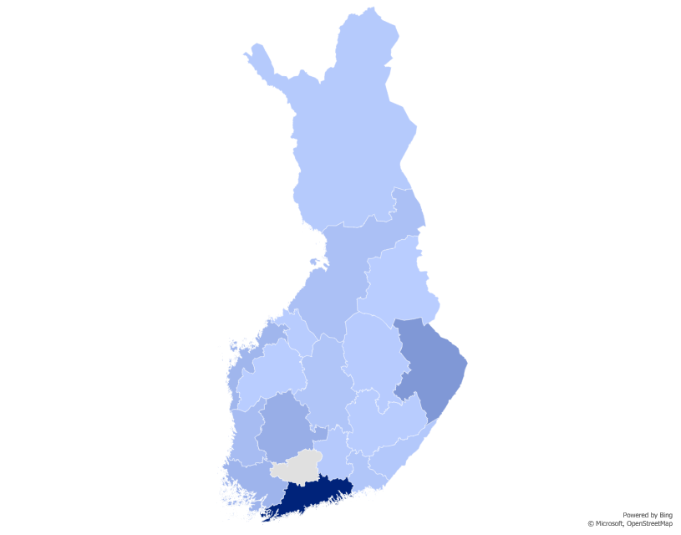
RRF FUNDING APPLICATIONS AREA DISTRIBUTION, MILLION EUROS
9
30
1
3
4
17
117
20
38
69
3
9
13
56
17
378
Notes:
Aputekstiä Teijalle:
In Finland, RRF funding has been concentrated in the regions with the highest number of companies. Uusimaa, North Karelia, and Pirkanmaa are at the top of the list, but all Finnish provinces have received RRF funding.

Slide 7

Some key points
The share of research and innovation investments in RRF funding in Finland has been the third largest out of all EU countries.
Companies have invested in new equipment and
production facilities.
The average RRF funding for one project
c. EUR 1 million.
The smallest projects granted less than EUR 100,000, the largest for Hydrogen economy (IPCEI) c. EUR 60 million and leading companies, c. EUR 20 million.
Finnish companies have met the DNSH criteria well and have commendably embraced the goals of the green transition.
!
Notes:
Mariam viimeistelee: Ykköskohta/Risto: Suomen kohdistaminen R&I on siis suhteellinen osuus maan RRF panostuksista. Ei absoluuttinen sillä isoimmilla mailla varmasti euroissa on enemmän.

Slide 8
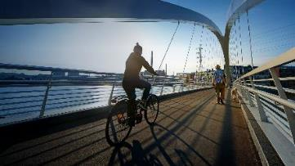
RRF support for internationalization:
EXAMPLE
Low-Carbon Built Environment
Boost for Export
Deliverables 3/22-12/23
Decarbonizing industries, EUR1 million
Low-carbon built environment, EUR 2 million
Health and wellbeing, EUR 1 million
Creative Business Finland, EUR 1 million
OFFERING DEVELOPMENT
  40+ top notch companies
CUSTOMER WORKSHOPS
  Five (5) customer workshops to ensure strong business and customer scope
MARKET STUDIES, MARKET STUDY WEBINARS AND TRADE MISSIONS
  H2/22- H1/23: 13 pcs
  H2/23: 8pcs (under work now)
  Customer feedback collected after each session
GLOBAL AWARENESS BUILDING FOR OFFERING: DIGITAL MARKETING LEAD GEN
  Six (6) market specific campaigns
  Master campaign based on learnings (5 markets)
  Insight and learnings to be shared with customers
Notes:
Satu M. lisää lukuja dian boxiin.
Aputekstiä Teijalle:
Decarbonizing industries EUR 2 million
The program funds decarbonizing innovations of Finnish industrial companies and promotes Finnish scalable decarbonizing solutions to markets, investors, and customers.
Low-carbon built environment EUR 1 million
The export program focuses on decarbonizing the built environment throughout the life cycle, from planning to maintenance. KARILTA ESIMERKKI
Health and wellbeing EUR 1 million
The program promotes the development of Finnish technological solutions in the health sector for the export market, research and innovative means of monitoring people's well-being and welfare services, and carries out planned cooperation to increase the recognition of Finland's expertise in the health sector.
Creative Business Finland EUR 1 million
Innovative solutions and robust understanding of customer experience are keys to international success. We challenge companies to re-think the true value they bring to their customers.

Slide 9
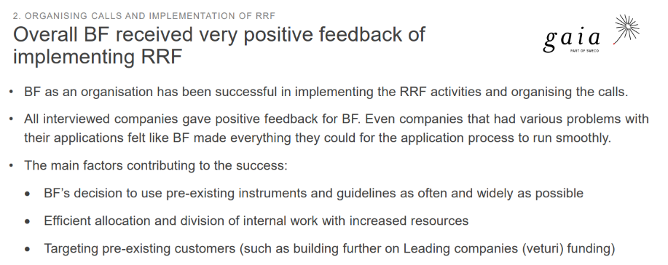
Customer feedback
According to an external evaluation, Business Finland received very positive feedback of implementing RRF
Notes:
Mariam mietttii tämän

Slide 10
Thank you!

