Slide 1
Research Council of Finland:
Investments of the
EU Recovery and Resilience Facility (RRF)
Promoting green and digital transition
Riitta Maijala, Vice-President for Research
Notes:
Huom. Logot vaihdetaan uusiin ja englanninkielisiin

Slide 2
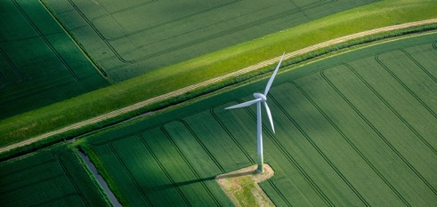


RRF reforms and investments support both EU and country-specific goals
In the country-specific recommendations for Finland in spring 2020, the EU Commission highlighted the need for investments required for the dual transition. According to the recommendations, Finland should target investments to:
Green and digital transition
Clean and efficient energy production and distribution
Research and innovation
Notes:
The reforms and investments support both EU objectives and the goals outlined in country-specific recommendations for Finland in which, the EU Commission highlighted the need for investments required for what is known as the dual transition.

Slide 3
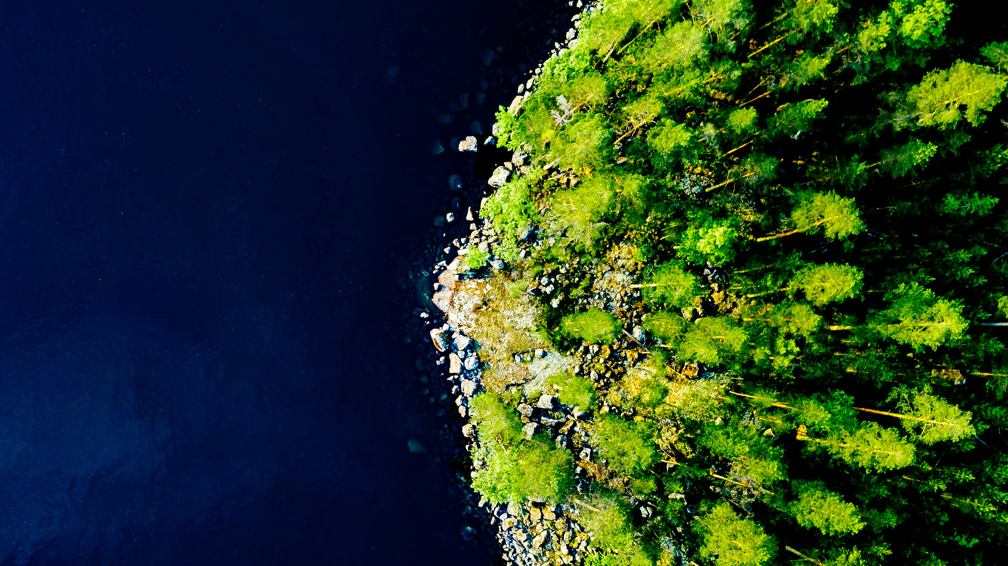
Finland’s Recovery and Resilience Plan (RRP)
Distribution of funding by four pillars
is part of the Sustainable Growth Programme for Finland.
The Council of the European Union approved the plan in May 2021.
The Research Council of Finland implements the Sustainable Growth Programme for Finland as part of the employment and skills pillar.
Notes:
Finland’s Recovery and Resilience Plan is part of the Sustainable Growth Programme for Finland. The national plan consists of four pillars: green transition, digitalisation, employment and skills, and social and health services.
The Research Council of Finland implements the Programme for as part of the employment and skills pillar, to which approximately 32% of the funding has been allocated. It is important to note that despite having their own pillars,
the green and digital transition also cut across the components. Approximately 50% of the funding is allocated to the green transition, while over 20% goes to the digital transition.

Slide 4
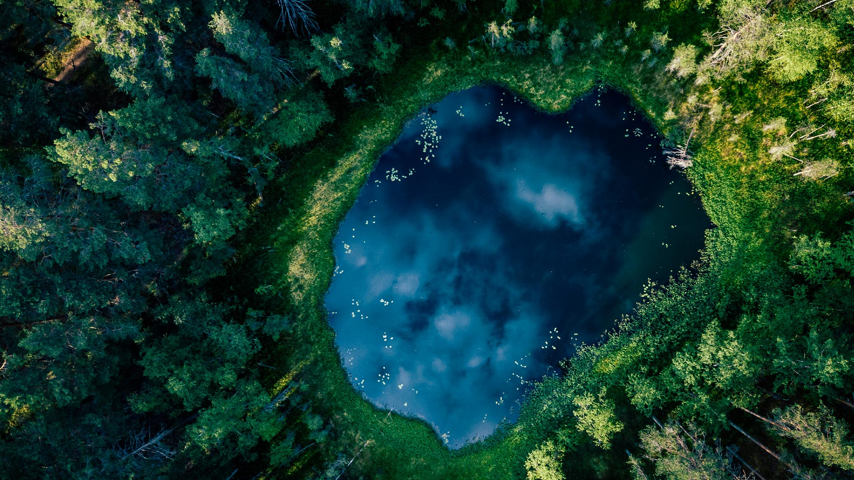
Green and digital initiatives for the benefit of a sustainable society and societal and individual wellbeing
The Research Council of Finland implements the following targets of the Sustainable Growth Programme for Finland:
PC3C3I2 Research infrastructure and piloting – RDI funding package supporting the green transition – Accelerating key industries of the future
PC3C3I5 Research infrastructure and piloting – Investments in RDI infrastructures supporting sustainable growth and digitalisation – Competitive funding for local research infrastructures
PC3C3I6 Research infrastructure and piloting – Investments in RDI infrastructures supporting sustainable growth and digitalisation – Competitive funding for national research infrastructures
Notes:
The Research Council of Finland implements three targets of the Finland’s Sustainable Growth Programme:
Research infrastructures and piloting supporting the green transition and
investments in infrastructures supporting sustainable growth and digitalisation including
2) Competitive funding for local research infrastructures and
3) Competitive funding for national research infrastructures
Business Finland implements the Sustainable Growth Programme in collaboration with the Research Council of Finland. Therefore, this event has also been organised in collaboration.

Slide 5

RRF-funded projects must comply with
Do No Significant Harm principle
They must not cause significant harm to these six environmental objectives:
Mitigation of climate change
Adaptation to climate change
Sustainable use and protection of water and marine resources
Transition to a circular economy, including prevention and recycling of waste
Prevention and control of environmental pollution
Protection and restoration of biodiversity and ecosystems
Notes:
In addition to the requirement of projects complying with relevant EU and national environmental legislation, the projects to be funded must comply with the DNSH principle, which states that projects must not cause significant harm to the six environmental objectives defined in the EU Taxonomy Regulation.
This has been evaluated for each of the eligible applications through six different aspects: (1) mitigation of climate change, (2) adaptation to climate change, (3) sustainable use and protection of water and marine resources, (4) transition to a circular economy, including prevention and recycling of waste, (5) prevention and control of environmental pollution, and (6) protection and restoration of biodiversity and ecosystems.

Slide 6
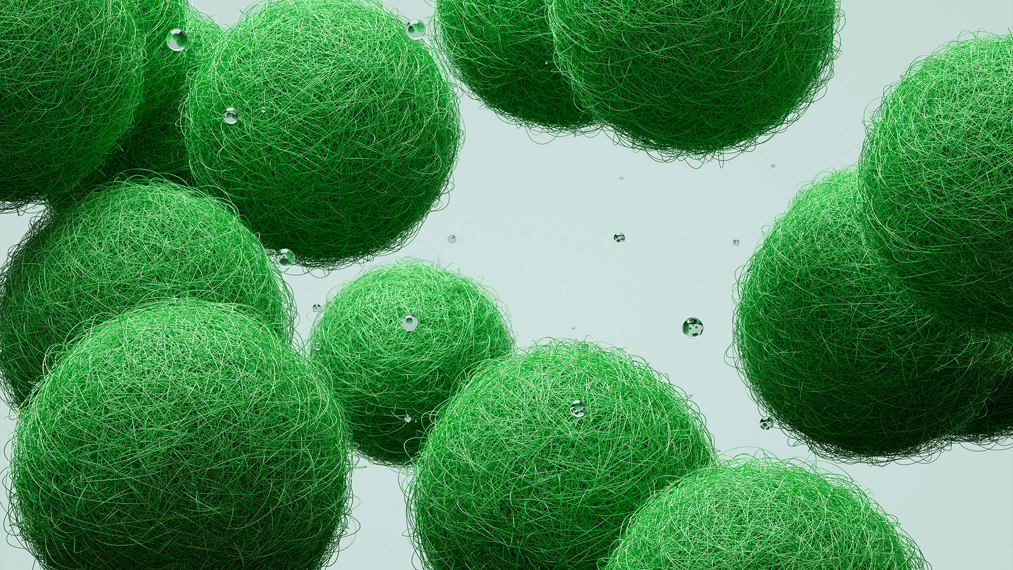
Distribution of RRF funding granted by Research Council of Finland
Total RRF funding
National Research Infrastructures (P3C3I6): €20m, 8 consortia,
44 beneficiaries
€89m
Key Areas of Green and Digital Transition (P3C3I2): €44m,
29 consortia, 101 beneficiaries
Local Research Infrastructures (P3C3I5): €25m, 19 consortia, 36 beneficiaries
Notes:
The total 89 million euros of RRF funding granted by the Research Council of Finland has been distributed to the three targets presented in an earlier slide:
44 million euros has been allocated to 29 consortia and 101 beneficiaries conducting research in key areas of green and digital transition
20 million has been allocated to 8 consortia and 44 beneficiaries hosting and developing national research infrastructures
25 million has been allocated to 19 consortia and 36 beneficiaries hosting and developing local research infrastructures

Slide 7
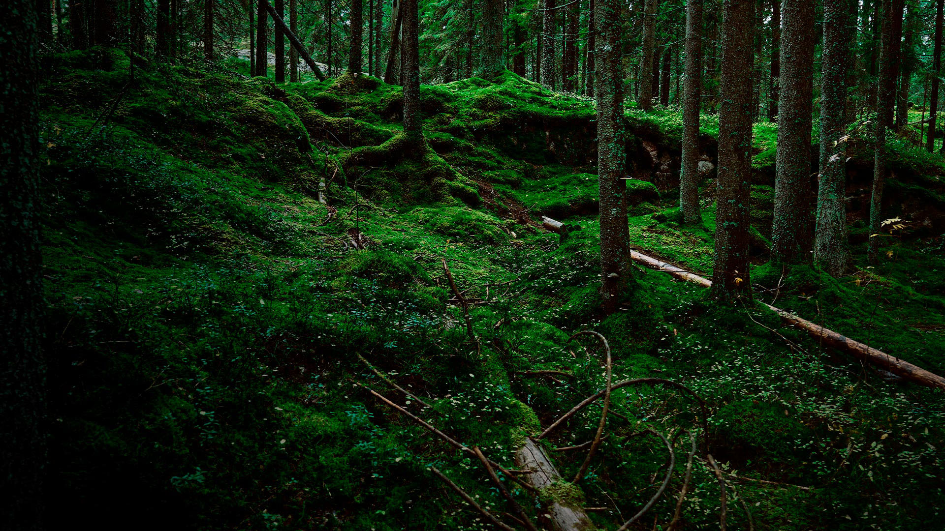
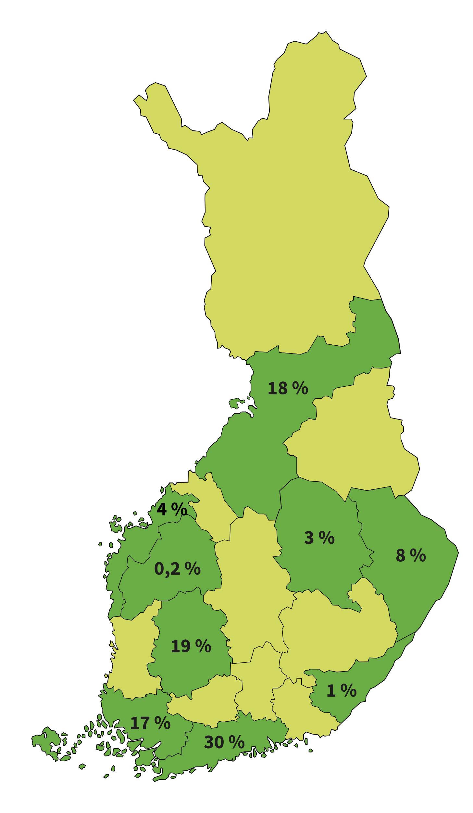
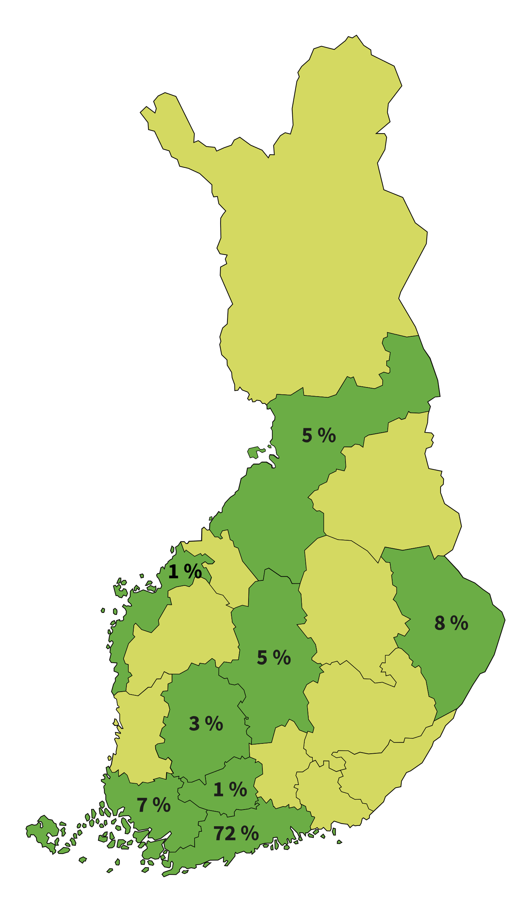
The Research Council of Finland has granted 89 million euros in competitive RRF funding for research in key areas of green and digital transition, national research infrastructures and local research infrastructures.
Distribution of RRF funding for local research infrastructure projects by region
Distribution of funding for research in key areas of green and digital transition by region
Notes:
The Research Council of Finland typically provides funding for national research infrastructures. Consequently, the distribution of RRF funding for national research infrastructures across Finland as a whole is straightforward: 100% of the funding.
Thanks to the opportunities created by the Recovery and Resilience Facility, the Research Council of Finland has, for the first time, been able to allocate funding for local research infrastructures. This type of funding was previously unavailable, as reflected in the map showing the widespread distribution of RRF funding across eight Finnish regions.
The RRF funding has primarily been awarded to Finnish universities and government research institutes. Given that many of the institutes have their headquarters in the capital region, and two of Finland's largest universities, the University of Helsinki and Aalto University, are located there, 72% of the RRF funding for key areas of green and digital transition has been allocated to the Uusimaa region. Funding has also been distributed to regions where other Finnish universities are situated.

Slide 8
Interdisciplinary research projects and research infrastructures promote the green and digital transition and related skills and expertise.
The Research Council of Finland’s RRF programme brings together 56 high-quality research and research infrastructure projects with high societal relevance, encompassing more than 80 research fields relevant to the green and digital dual transition.
The most typical research areas within the RRF programme
Notes:
Graafi tulossa englanniksi
The Research Council of Finland’s RRF programme brings together 56 high-quality research and research infrastructure projects with high societal relevance, encompassing over 80 research fields relevant to the green and digital dual transition.

Slide 9
Key areas research projects and research infrastructures funded by the Research Council of Finland presented today in the networking session
Digitizing the Carbon Sink Potential of Boreal Lakes
Sustainable Carbon-Neutral Aerial Ecosystems and Energy Solutions
From Primary Heating Source to Multifuel Heating
Enabling Demand Response through Easy-to-Use Open-Source Approach
Artificial Intelligence –Guided CO2 Conversion
Achieving Carbon Neutrality at the Regional Level
Vaasa Zero Emission Data Centre
Climate-Smart Health Technologies
The RRF-funded research projects and research infrastructures create new centres of expertise, accomplish extensive goals and represent the highest level of Finnish research in terms of achieving the objectives.
Notes:
The broad range of research topics and research infrastructures funded by the Research Council of Finland will be presented later today during the networking session. We hope that you will be able to participate also in that session of the event.
The RRF-funded research projects and research infrastructures create new centres of expertise, accomplish extensive goals and represent the highest level of Finnish research in terms of achieving the objectives.

Slide 10
Thank you!
For more information on the research and research infrastructures: www.aka.fi/en/rrf

