Slide 1

AI-guided CO₂ conversion
An AKA/RRF project
Árpád I. Toldy, PhD
17.10.2023, Musiikkitalo
‚computer code and molecules in a chemistry flask’, DALL-E2, 10.10.2023

Slide 2











Linear and Circular Carbon Economy
CO₂
Green H₂
Carbon Capture and Utilization (CCU)

Slide 3
Reducing the cost
New catalysts
Improved processes
PROCESS
GREEN H₂
AIcon
(for methanol)

Slide 4
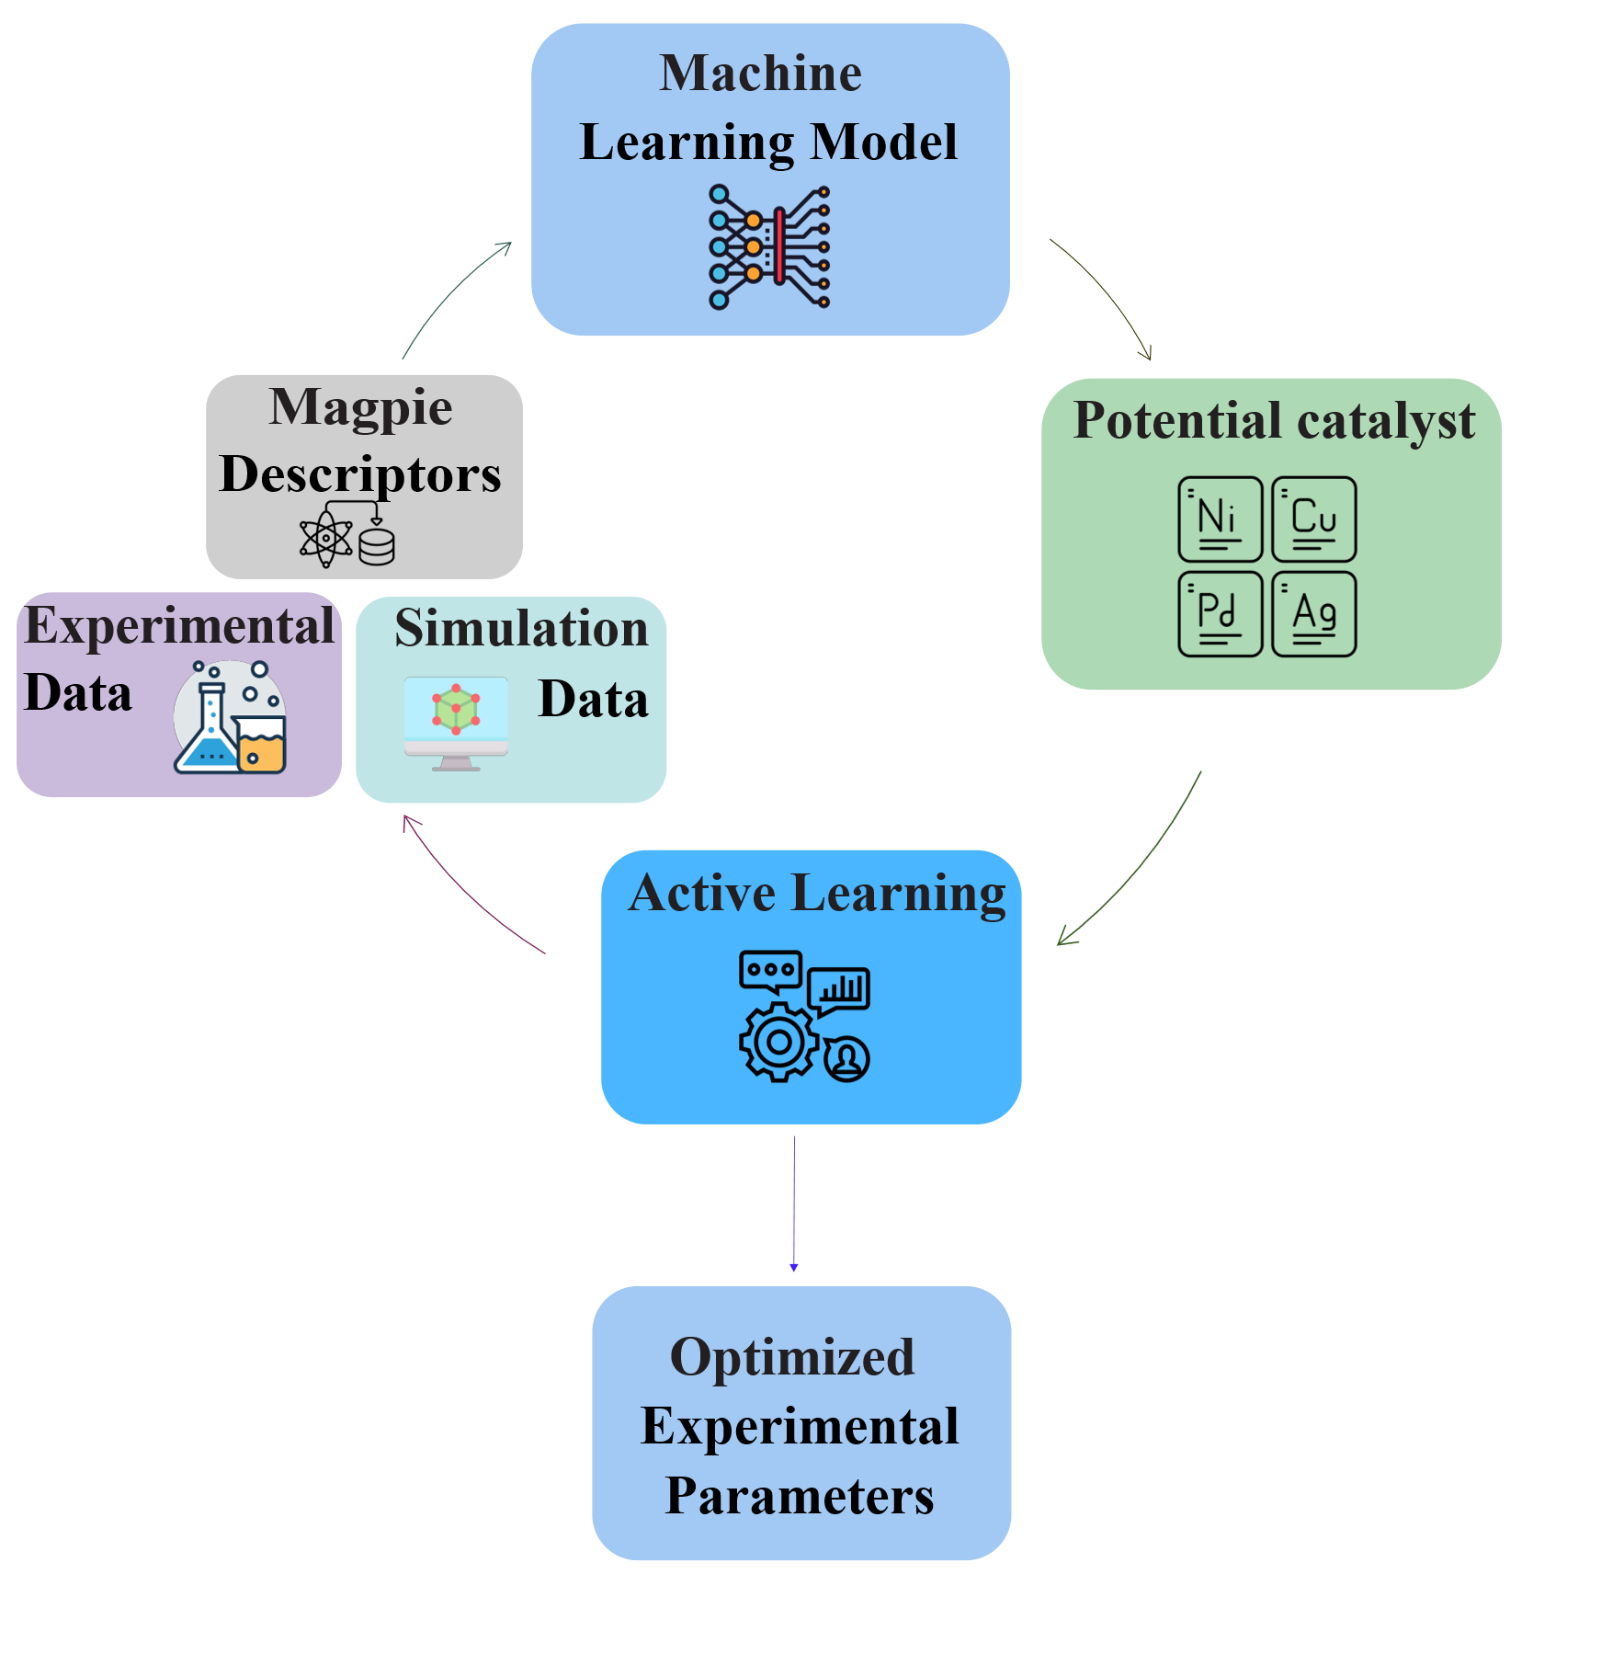
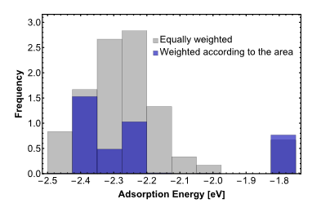
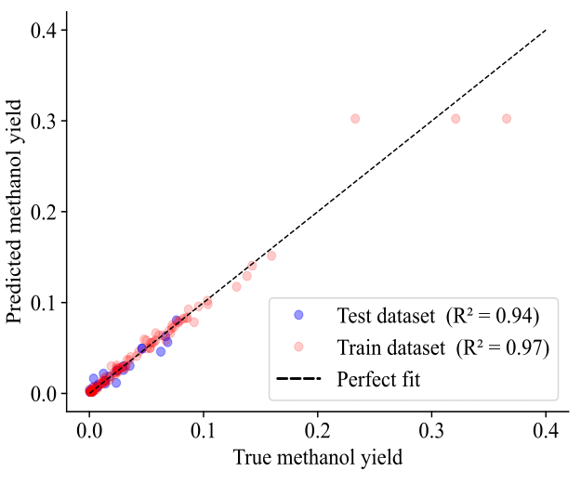
The AIcon Approach
Achievements 2022-2023:
Developed simulation and ML workflow
Created database
First predictions of new catalysts
First round of new catalysts synthesized
Successful research visit of 2 scientists in the US
6 presentations at conferences

Slide 5
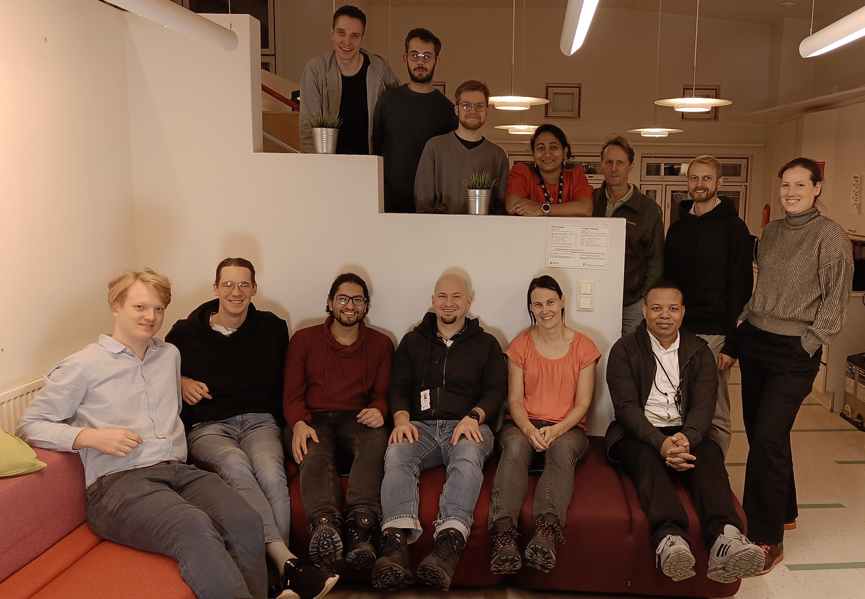
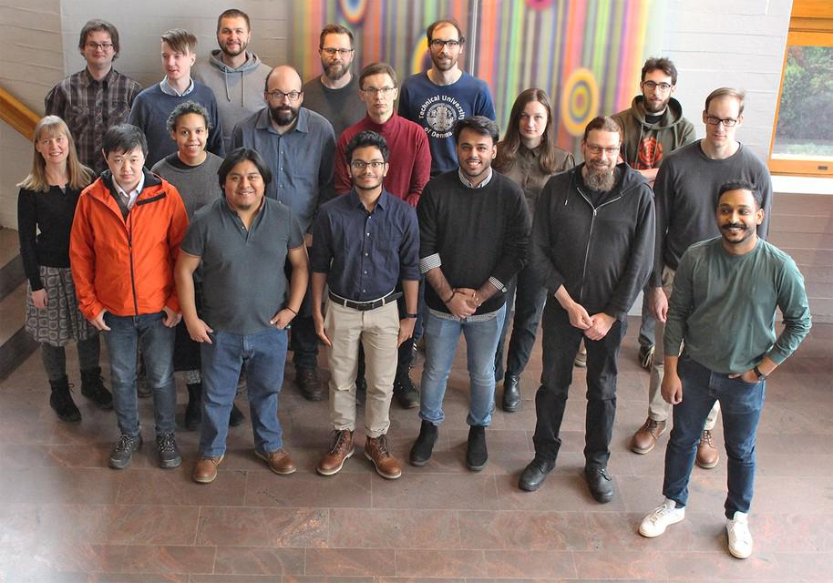
Collaboration!
DFT and material search ML framework setup by Prof. Patrick Rinke’s group
Experiments & database creation by Prof. Annukka Santasalo-Aarnio’s group
Notes:
- Engineering and science → we do experiments, they do the data-driven stuff

Slide 6


Thank you!

