Slide 1
Zero Emission Marine
A leading company ecosystem programme

Slide 2
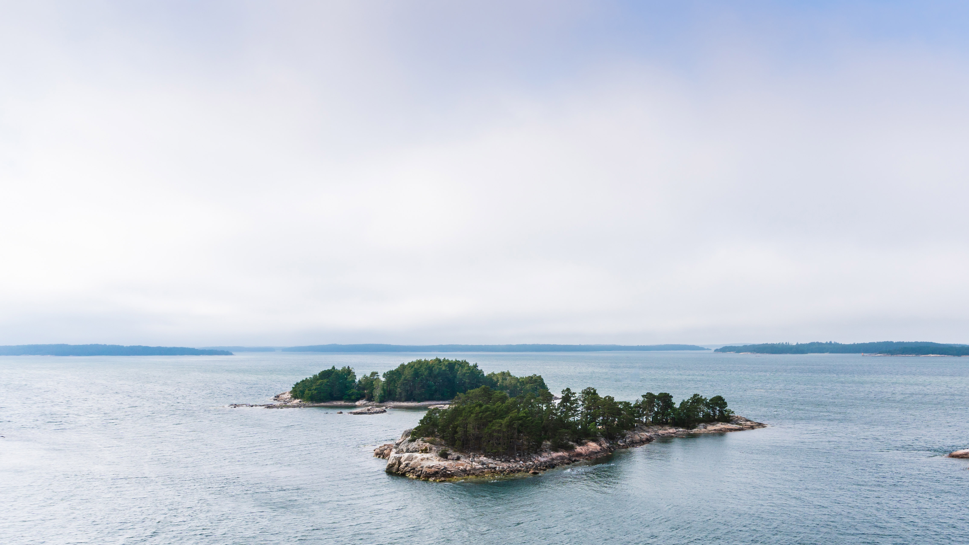
VISION:
MISSION:
OBJECTIVES:
A Zero emission marine Future
Creating an economically compelling zero-emission marine ecosystem driving sustainable technology solutions and services
With the ecosystem’s collective over 300 million euro increase in R&D spend over the coming years, we will develop new competitive skills, human capital and world-class services and solutions, enabling the creation of additional annual revenue to Finland of one billion euros per year by 2030.
This will enable us to reach 60% GHG reduction in the maritime industry by 2030 and 100% reduction by 2050 all the Wärtsilä Veturi ecosystem products are carbon-neutral or carbon-negative.
60% GHG reduction
in the maritime industry by 2030

Slide 3

Wärtsilä roadmap for Veturi project Zero Emission Marine
Technologies enabling introduction of green fuels
Green fuel production
Automated and optimized operations – increased level of autonomy
Outcome based business models – OBBM
Technology transfer from Marine to Energy
Wärtsilä’s effort
Ecosystem effort

Slide 4
zemecosystem.com

