Slide 1




Climate-smart health technologies:
Impacts on carbon footprint of health care
KUVA: ADOBE STOCK
Atte Pitkänen
Researcher

Slide 2
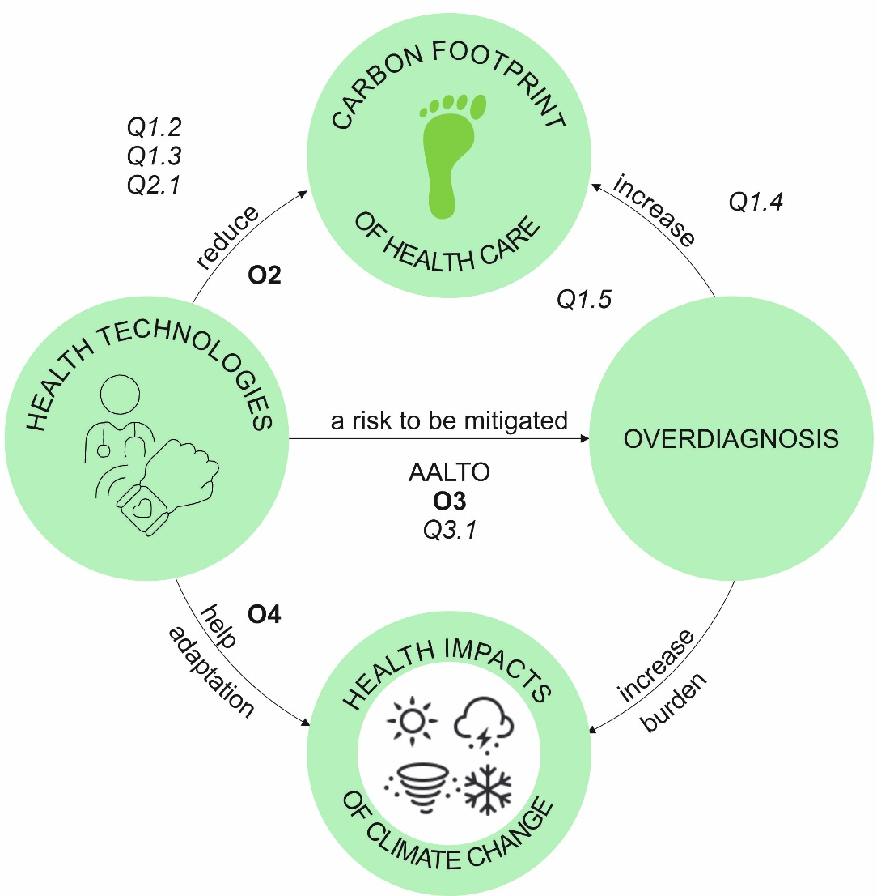

Climate-smart health technologies (CLISHEAT)
Aims of the Syke research group:
Carbon footprint of Finnish healthcare
Carbon footprint impacts of new health technologies
Identifying applications with significant emission reduction potential
Carbon footprint research with our CLISHEAT partners (University of Turku, University of Helsinki, Aalto University)
Impact:
To support the decarbonization of healthcare

Slide 3
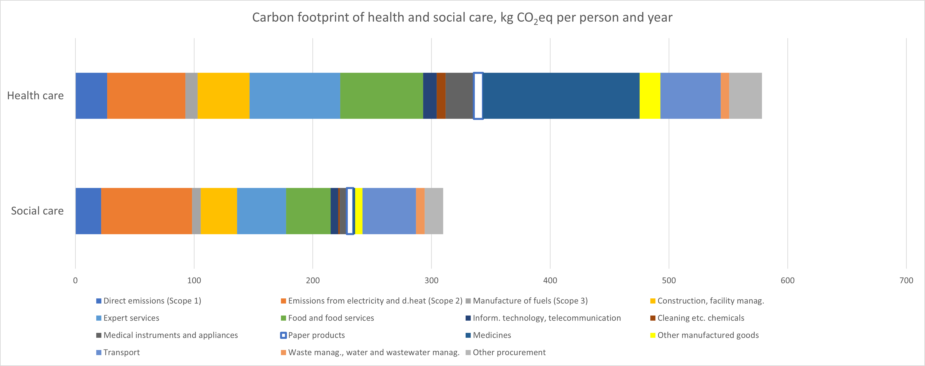
Carbon footprint of healthcare
Healthcare is responsible for 5.2% of global GHG emissions (Romanello et al., 2022)
We have assessed that healthcare contributes to 4.2% of the consumption-based GHG emissions of Finland
Ari Nissinen & Hannu Savolainen, SYKE, Eko-Sote and CLISHEAT projects.
Romanello et al. 2022. The Lancet. 400(10363),1619-1654.

Slide 4
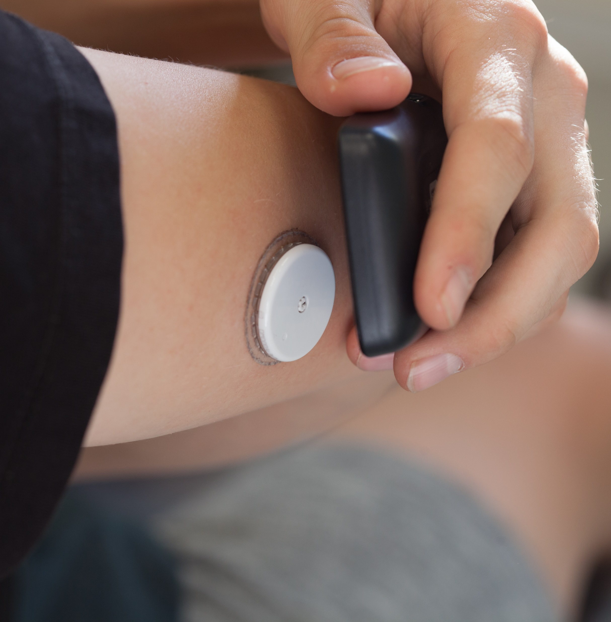
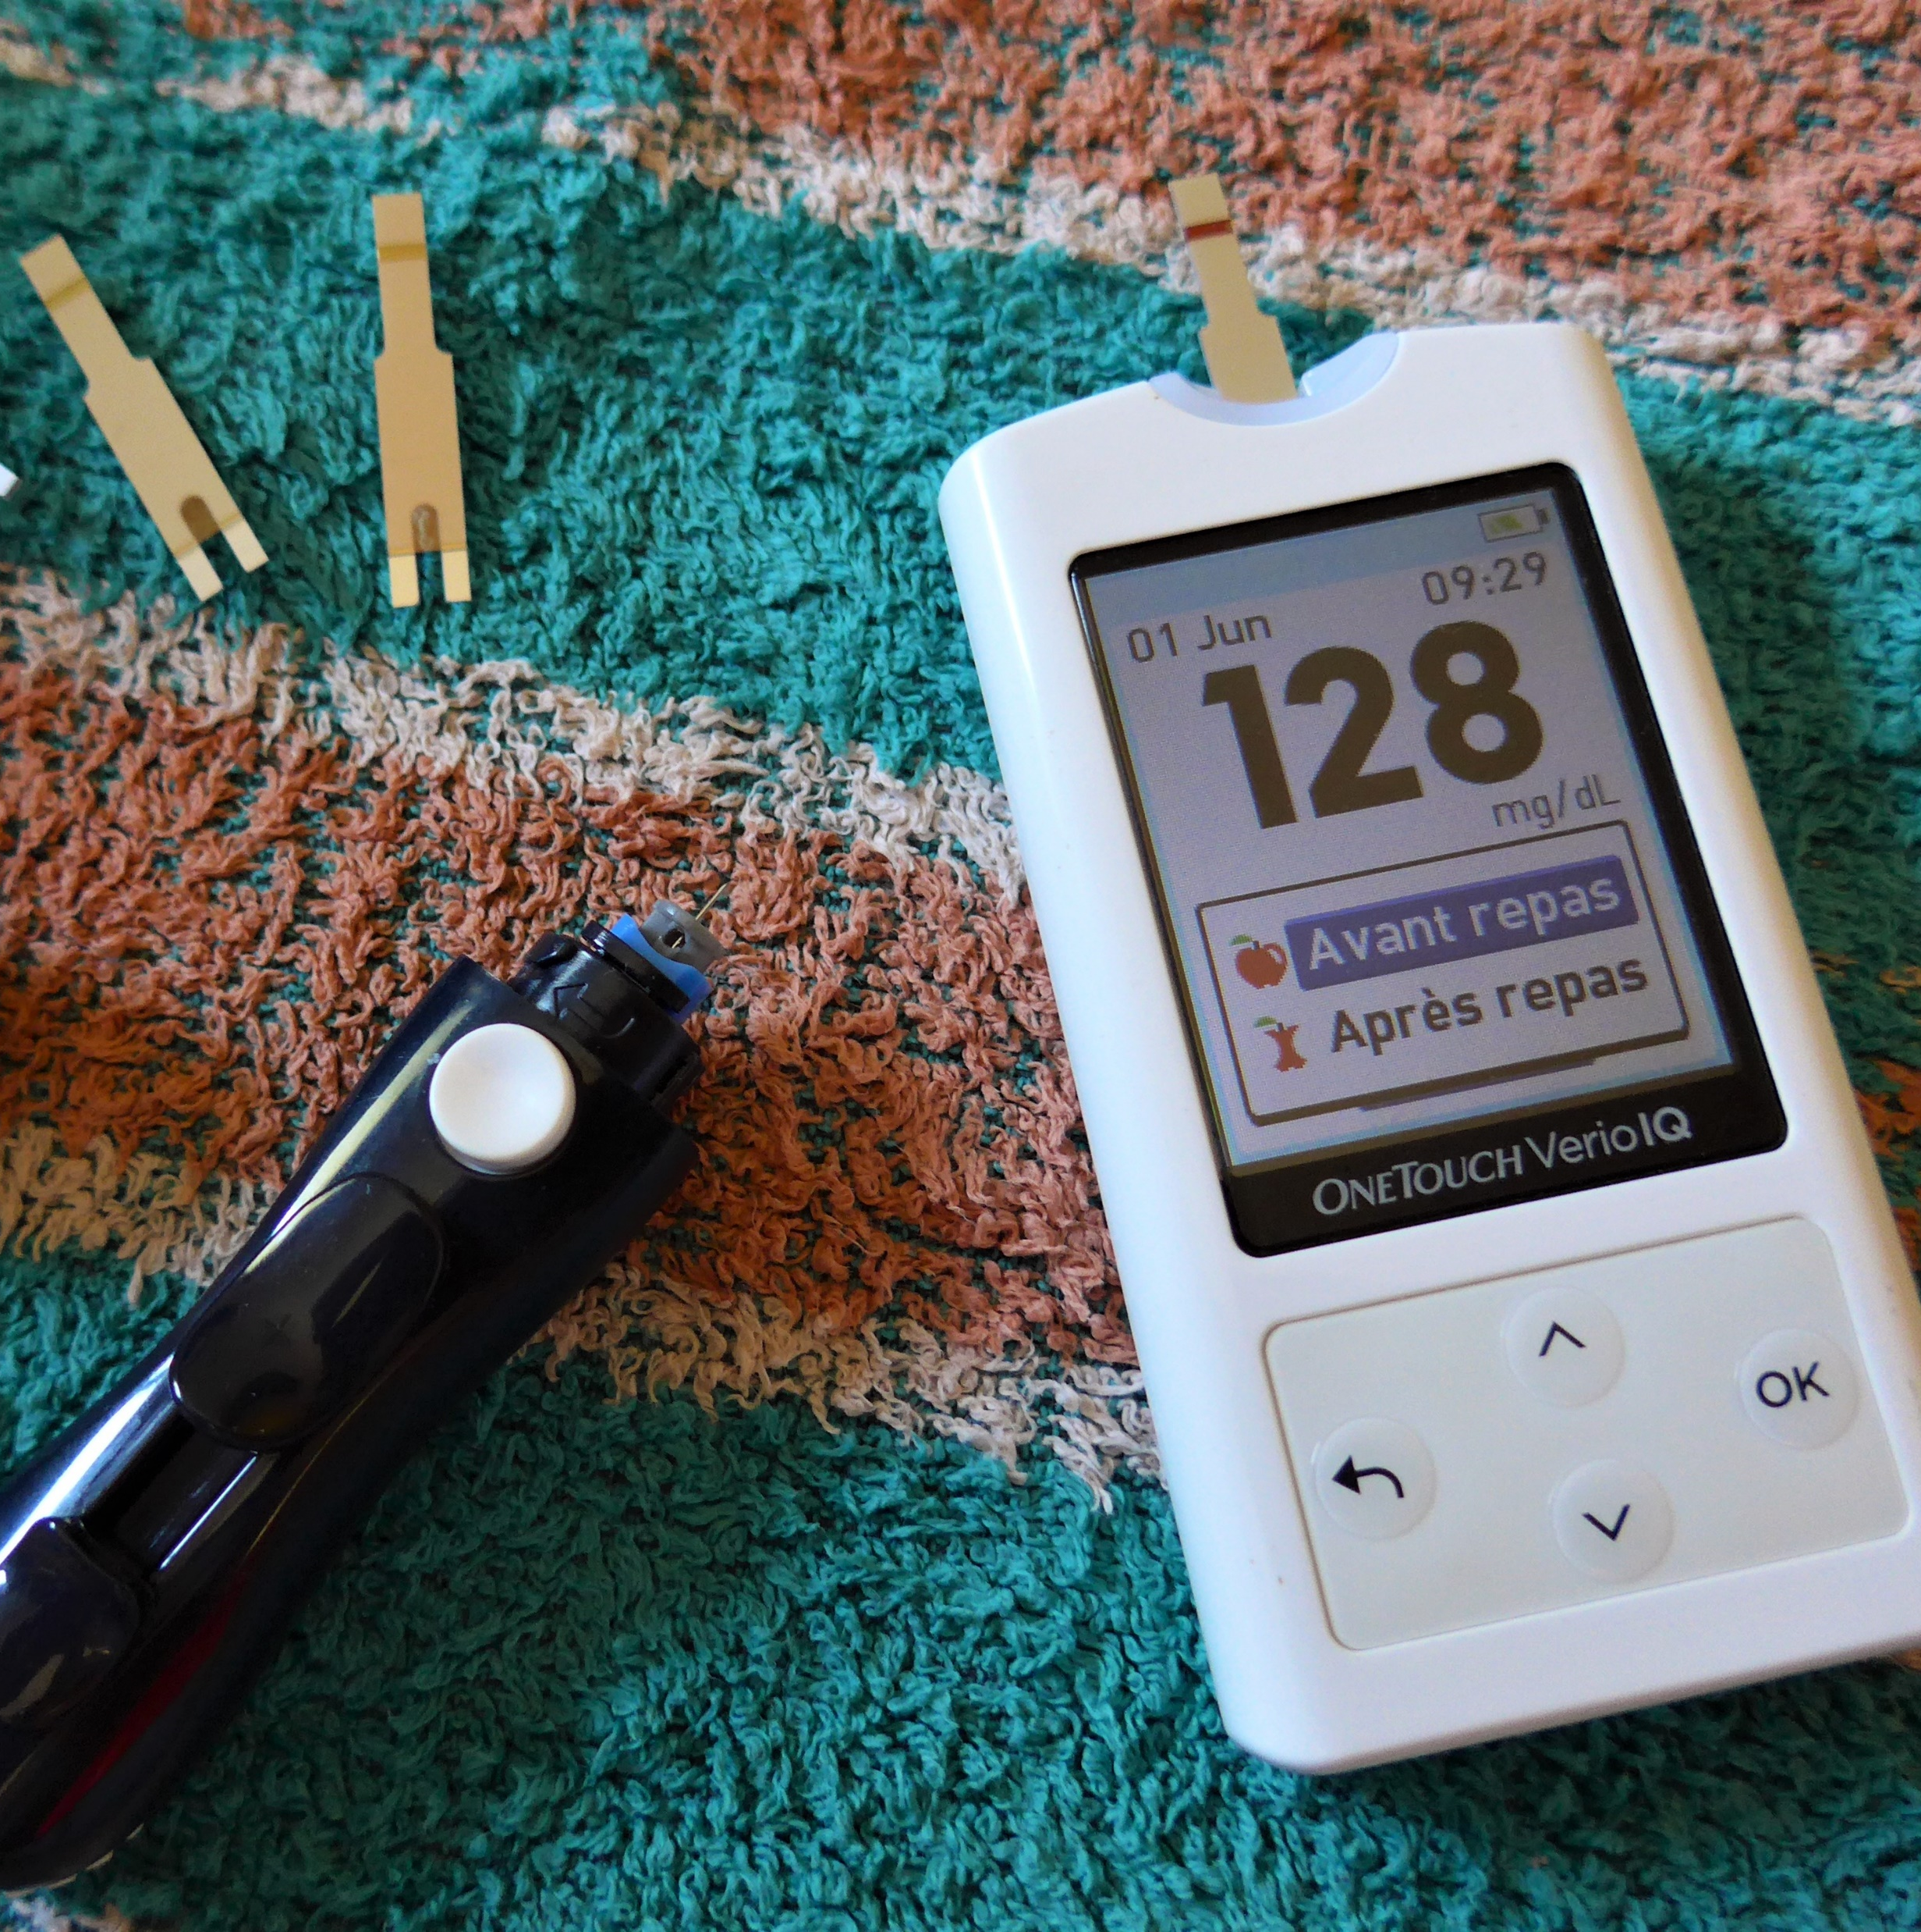
Carbon footprint of continuous glucose monitoring vs. self-monitoring of blood glucose
Photo: Thirunavukkarasye-Raveendran
Licensed under CC BY-SA 4.0.
Source: Wikimedia Commons.
Comparative carbon footprint assessment and the identification of carbon hotspots:
CGM lifetime is currently 14 days, after which the sensor is disposed
Number of test strips and lancets per day (1 to 10)
Photo: Celeda
Licensed under CC BY-SA 4.0.
Source: Wikimedia Commons.
←
→

Slide 5
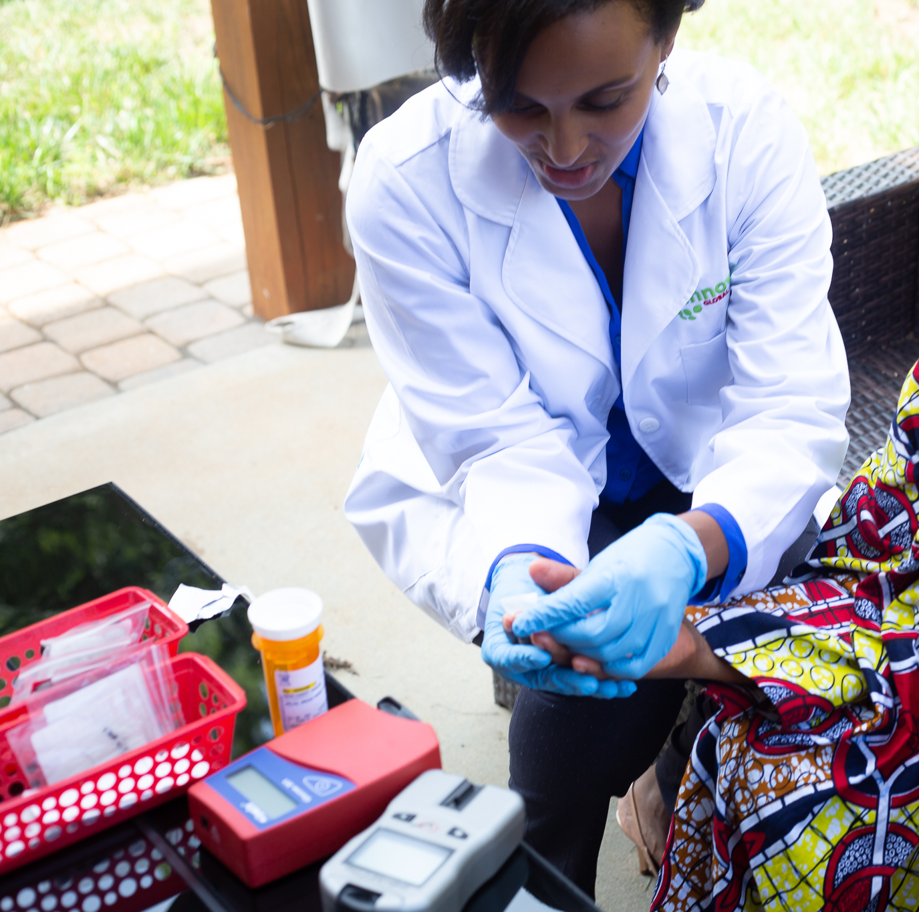
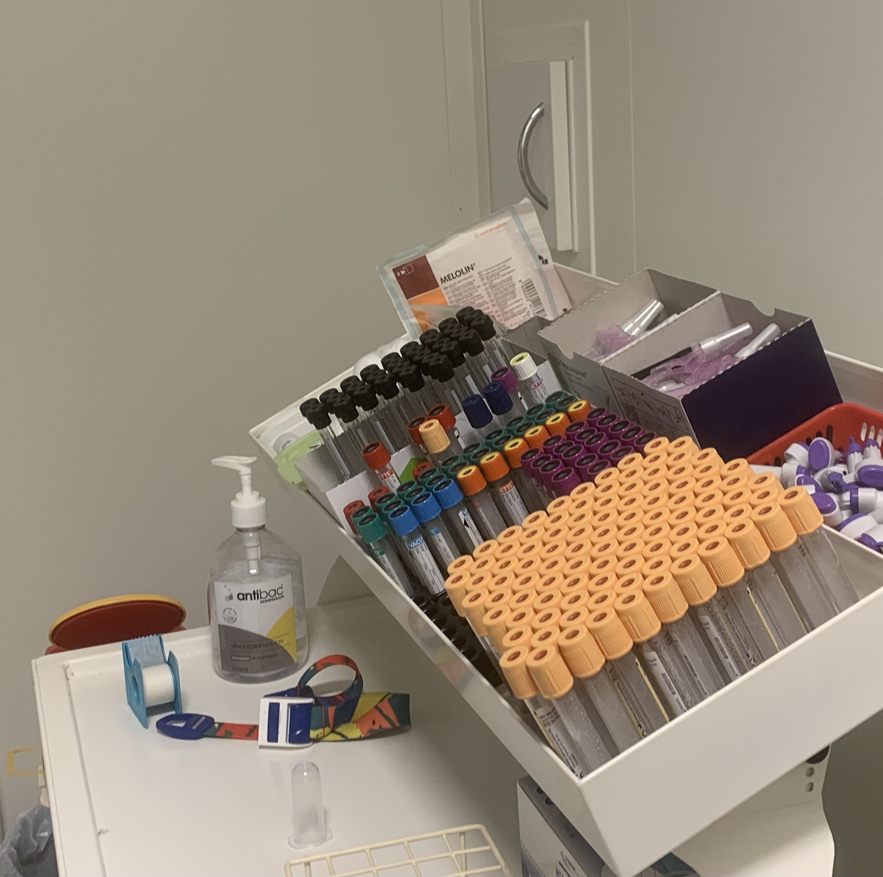
Carbon footprint of point-of-care testing vs. laboratory testing of C-reactive protein
Comparative carbon footprint assessment and the identification of carbon hotspots:
Sample collection consumables in laboratory testing
Less consumables in point-of-care testing
Electricity consumption of analysers per sample
Photo: Haddy Sowe
Licensed under CC BY-SA 4.0.
Source: Wikimedia Commons.
Photo: Marius Vassner.
Licensed under CC BY-SA 4.0.
Source: Wikimedia Commons.

Slide 6
Thank you!
atte.pitkanen@syke.fi

